Slide 1
SKIP
SKIP
SKIP
Averages
Emojis
In the mix
You will be asked a question with a numerical answer.
Your team’s answer is the average of each members’ answer.
The team with the closest answer to the correct answer wins.
A member of the team will be asked to describe an event, film, etc, using only emojis.
The remaining members have to guess the event, film, etc, within the time limit. If time runs out, the other teams can steal the point.
A member of the team will be asked to describe an event, film, etc, using 3 words. The other teams will also add 1 word each to the clues. The remaining members have to guess the event, film, etc, within the time limit.

Slide 2
SKIP
SKIP
SKIP
(Pairs only)
Out of the mix
Two words
Timeline
A member of the team will be asked to describe an event, film, etc, using 3 words. The other teams will provide 1 word each. If any word from the other teams matches that from the member, that word is removed from the clues.
You will be asked a question with two word answers.
You need to provide one of the words while your teammate provides the other word. The team with a correct two word answer wins.
You and your teammate are given 2 different events. Your team has to create the timeline correctly when the events occurred relative to an event in the board.

Slide 3
SKIP
In the mix 2
A member of the team will be asked to describe an event, film, etc, using 3 words. The other teams will add 1 option each to the answer options. The remaining members have to choose the correct answer.

Slide 4
Averages
Averages
Averages
How many sports
were in the 2020
Tokyo Olympics?
How many sports
were in the 2020
Tokyo Olympics?
How many sports
were in the 2020
Tokyo Olympics?
Your team’s answers are
|
48
48
23
12
Your team’s average is
SEND
SEND
27.67

Slide 5
Averages
Averages
How many sports
were in the 2020
Tokyo Olympics?
Round 1
Question 1/5
26
team1
1
team1
27.67
team2
0
team2
23
team3
0
team3
22.2

Slide 6
Emojis
Emojis
Emojis
Use only emojis
to describe the
2020 Tokyo Olympics
Use only emojis
to describe the
2020 Tokyo Olympics
Guess the event
Waiting for clues…
|
🏀🏆🏊🗼⛩🗻
|
SEND
SEND
SEND

Slide 7
Emojis
Emojis
Emojis
Guess the event
Guess the event
Round 2
Question 1/5
🏀🏆🏊🗼⛩🗻
🏀🏆🏊🗼⛩🗻
team1
5
|
2020 Tokyo Olympics
team2
2
team3
1
SEND
SEND

Slide 8
In the mix
In the mix
In the mix
Give 1 word to confuse the other team when guessing the 2020 Tokyo Olympics
Use 3 words to describe the
2020 Tokyo Olympics
Guess the event
Your teammate is typing…
|
|
|
SEND
SEND
SEND

Slide 9
In the mix
In the mix
In the mix
Guess the event
Guess the event
sports, medal, movie, boxing, japan
sports, medal, movie, boxing, japan
Round 3
Question 1/5
team1
7
|
2020 Tokyo Olympics
team2
2
team3
3
SEND
SEND

Slide 10
Out of the mix
Out of the mix
Out of the mix
Give 1 word that you think the other team will use to describe the 2020 Tokyo Olympics
Use 3 words to describe the
2020 Tokyo Olympics
Guess the event
Waiting for clues…
|
|
|
SEND
SEND
SEND

Slide 11
Out of the mix
Out of the mix
Out of the mix
Guess the event
Guess the event
sports, medal
sports, medal
Round 4
Question 1/5
team1
8
|
2020 Tokyo Olympics
team2
2
team3
3
SEND
SEND

Slide 12
Two words
Two words
Two words
Who is the author of Blink, Outliers, The Tipping Point?
Who is the author of Blink, Outliers, The Tipping Point?
Who is the author of Blink, Outliers, The Tipping Point?
Your team’s answers are
Malcolm
Malcolm
Malcolm
SEND
SEND
Malcolm

Slide 13
Timeline
Timeline
Timeline
When was the first Olympics held?
When was the start of World War II ?
World War I
1914 - 1918
Your team’s answers are
1920
SEND
SEND
1945

Slide 14
Timeline
Timeline
Timeline
First Olympics
1896
World War I
1914 - 1918
World War II
1939
When was start of World War II ?
World War I
1914 - 1918
Your team’s answers are
Your team’s answers are
1920
1920
SEND
1945
1945

Slide 15
In the mix 2
In the mix 2
In the mix 2
Give 1 option to confuse the other team when guessing the 2020 Tokyo Olympics
Use 3 words to describe the
2020 Tokyo Olympics
Guess the event
Your teammate is typing…
|
|
|
SEND
SEND
SEND

Slide 16
In the mix 2
In the mix 2
In the mix 2
Guess the event
Guess the event
sports, medal, japan
sports, medal, japan
Round 3
Question 1/5
team1
7
2020 Tokyo Olympics
2016 Rio Olympics
2020 Tokyo Olympics
2016 Rio Olympics
London Olympics
Tokyo Marathon
London Olympics
Tokyo Marathon
team2
2
team3
3
SEND
SEND

Slide 17
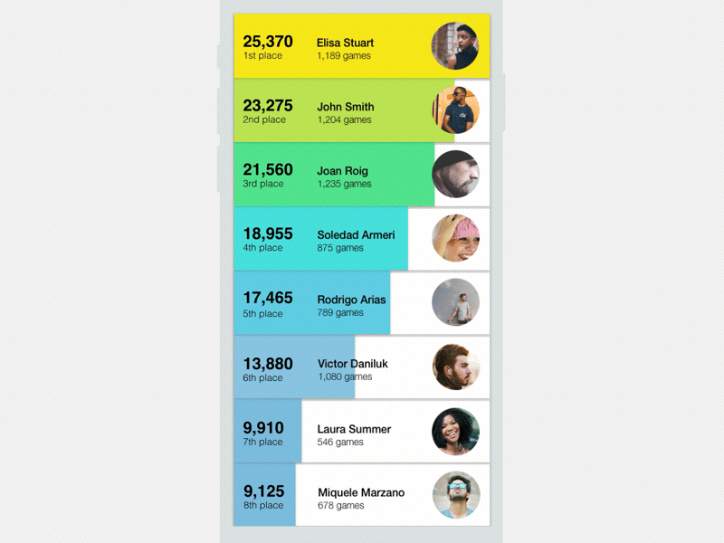
10 team 1
8 team 2

